Slide 1


PradushanCheck: Comprehensive Air Quality Monitoring and Forecasting
Project Mentor : Dr. Gresha S Bhatia
(Deputy Head, Dept of CMPN)
Group Number : 8
Group Members :
Ashutosh Mishra (D17C,36)
Nikhil Haswani (D17A, 22)
Muskan Chhabria (D17C, 13)
Vanshika Thakur (D17C, 57)

Slide 2
Content
Introduction to Project
Lacuna in the existing systems
Problem Definition
Literature Survey
Block Diagram
Modular Diagram
System Diagram
Methodology employed
Hardware, Software, tools and the constraints
Implementation & Results
Limitation
Conclusion and Future Scope
References

Slide 3
Introduction
The Urgent Need for Air Quality Monitoring
Rising Concerns: The escalating concerns regarding the detrimental impacts of air pollution on human health and the environment have spurred a growing demand for efficient air quality monitoring and management systems.
Motivation: The urgent and expanding issue of air pollution, particularly prevalent in urban areas worldwide, is what motivates us to conduct this study. The main objective of our initiative becomes evident when one considers the grave health risks and environmental consequences that poor air quality poses, especially in rapidly developing nations like India.

Slide 4
Lacuna in the existing system
Visualization of air pollution in a particular city based on the parameters related to air pollution.
The presence of Outliers or anomaly detection can affect the model to decrease its accuracy and the data we use may have some outliers / anomalies, i.e. the values which are dissimilar with the other values which can affect the ML model.
The outlier detection is one of the unfilled spaces, as it can affect the accuracy of our model.

Slide 5
Problem Definition
“Applying Machine Learning techniques to forecast the possibility of Air Pollution in an Urban Environment,” involves the development and application of machine learning models to predict future levels of air pollution in urban settings.
The task requires the use of historical and current air quality data, which includes various pollutants like PM2.5, PM10, NO2, SO2, CO, O3, etc., to train machine learning algorithms.
The goal is to accurately forecast air pollution levels, which could be represented as the Air Quality Index (AQI) or concentrations of specific pollutants.
The focus on urban environments is crucial as these areas typically have different pollution sources and patterns compared to rural areas and tend to have more air quality monitoring stations providing high-resolution spatio-temporal data.
Accurate predictions can aid in timely decision-making and planning for pollution control measures, contributing significantly to improving public health and environmental conditions.

Slide 6
Literature Survey
Title | Year | Methodology | Tech tools
Prediction of Air Quality Index Using Machine Learning Techniques: A Comparative Analysis | 2023 | In this paper, the proposed methods use three different algorithms to draw a comparative analysis of the AQI values of New Delhi, Bangalore, Kolkata, and Hyderabad by using parameters such as PM2.5, PM10, NO, NO2, NOx, NH3, CO, SO2, O3, Benzene, and toluene levels, which will then compare the three algorithms and fnd the most accurate and efficient algorithm. Te aim is to analyze and present it in an efficient way. It would help us discover interesting and insightful information. Tese particular cities have a higher population density and give a good estimate of the pollution in a major South Asian city. | Synthetic Minority Oversampling Technique (SMOTE) Algorithm. Synthetic samples are created for the minority class using this oversampling technique. It aids in making an imbalanced dataset balanced. Tis approach helps with beating the issue of overfitting brought about by arbitrary oversampling.

Slide 7
Literature Survey
Title | Year | Methodology | Tech tools
Urban Air Quality Prediction using Regression Analysis | 2019 | A reliable method of identifying which variables have an impact on a topic of interest(in this case our AQI values) is regression analysis. Which factors matter most, which factors can be ignored, and how these factors influence each other can be confidently determined by performing regression. The variable which is being predicted is called the dependent variable. In our paper, it’s the AQI value. Factors that we assume to have an effect on the dependent variable are called independent variables. The various weather phenomena come under this category. | We can run the model on Python 2.7 (or higher) x64 machine with 8GB RAM, 2.3Ghz intel i7 CPU using the standard visualization and sklearn packages. The majority of work like loading, and handling the null data was implemented using the pandas DataFrame. The dataset was then trained and tested with an approximate ratio of 7:3, ie 4400 train values and 2000 test values. The trained dataset was then fit to predict values using various regression algorithms like Linear Regression, Neural Network Regression, Decision Forest, etc., and compare the results.

Slide 8
Literature Survey
Title | Year | Methodology | Tech tools
Prediction of Air Quality Index Based on LSTM | 2021 | For solving this problem, we use Long Short Term Memory, which is a kind of time Recursive Network Nerve. It is suitable for processing and predicting important events with relatively long intervals and delays in time series. LSTM is different from RNN mainly because it adds a processor to the algorithm to judge whether the information is useful or not. The structure under which the processor is called a cell. | With the standard visualization libraries, we can visualize the data and use the Neural Networks or the Long Short Term Memory (LSTM) model.

Slide 9
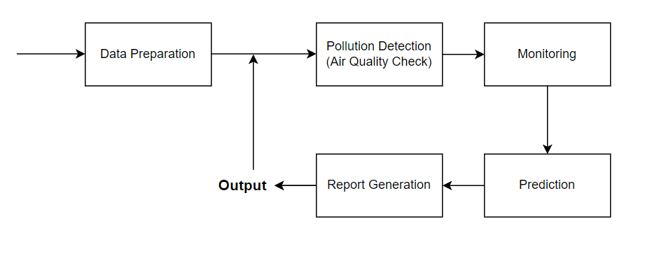
Block Diagram

Slide 10
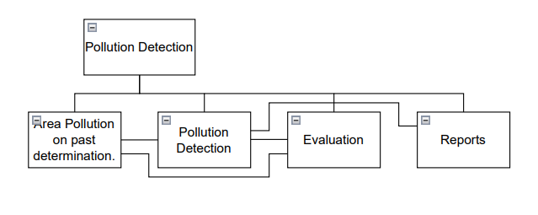
Modular Diagram

Slide 11
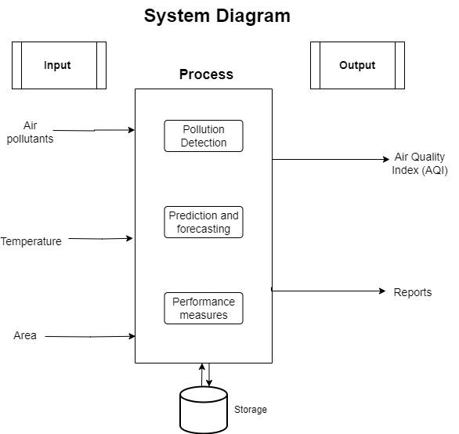
System Diagram

Slide 12
Methodology Employed
Define the target variable (e.g., air quality index or pollutant concentration) and the input features (e.g., meteorological data, traffic data, land use data, etc.)
Collect and preprocess the data from relevant sources (e.g., air quality monitoring stations, satellite images, weather stations, etc.)
Choose a machine learning algorithm that suits the problem (e.g., support vector regression, random forest, neural network, etc.)
Train and validate the model using appropriate metrics (e.g., mean absolute error, root mean square error, coefficient of determination, etc.)
Test the model on unseen data and evaluate its performance.
Interpret and communicate the results and insights.
Air Quality Status, Awareness and Mitigation Measures.

Slide 13
Algorithms Compared
Ensemble Methods: In machine learning refer to techniques that combine multiple individual models to improve predictive performance and Generalization.
Types of Ensemble Methods:
Bagging: Describe how it builds multiple models independently and combines them through averaging.
Boosting: Explain how it builds models sequentially, focusing on misclassified instances to improve overall performance.
Stacking: Introduce the concept of training a model to combine the predictions of multiple models.
Challenges and Considerations:
Computational Complexity: Discuss the additional computational resources required for training multiple models.
Interpretability: Address the trade-off between performance and the interpretability of the ensemble models and does not work on time series.

Slide 14
Algorithms Compared
We have compared below Ensemble methods:
Random Forest Regressor
Support Vector Regression
Catboost Regression
Random Forest Regressor:
Random Forest Regressor is an ensemble learning method based on the concept of decision trees. It builds multiple decision trees during training and merges them together to get a more accurate and stable prediction.
Random Forest Regressor uses a technique called bagging (Bootstrap Aggregating) to build multiple decision trees. Bagging involves creating multiple bootstrap samples (random samples with replacement) from the training dataset and training a decision tree on each sample.
Random Forest Regressor provides a measure of feature importance, which indicates the contribution of each feature in the prediction process.

Slide 15
Algorithms Compared - SVR
2) Support Vector Regressor:
Support Vector Regressor is a type of supervised learning algorithm that performs regression tasks by finding the hyperplane that best fits the data while maximizing the margin between the hyperplane and the data points.
SVR introduces an epsilon parameter, which defines a margin of tolerance around the predicted value. The goal of SVR is to ensure that the prediction falls within this margin of tolerance, or epsilon, for each data point.
It aims to minimize the error while still fitting the data within the margin of tolerance

Slide 16
Algorithms Compared - Catboost Regressor
3) Catboost Regressor:
CatBoost Regressor is an implementation of the gradient boosting algorithm designed to handle categorical features efficiently. .
This approach maintains the natural ordering of categorical variables and avoids the common issues associated with traditional encoding techniques, such as high memory usage and potential information loss.
CatBoost Regressor employs several optimizations to enhance the training process and improve predictive performance. It utilizes a novel algorithm for feature importance calculation, which provides insights into the relative importance of different features in predicting the target variable.

Slide 17
Hardware, Software, Tools and constraint
Minimum Hardware Requirements:
Processor: Intel i3 or AMD equivalent
Disk Space: 4GB
RAM: 8GB
GPU: NVIDIA GPU
Software Requirements: Google colab (Python & ML)
HTML, CSS, Javascript, ReactJS
Tableau for visualization.

Slide 18
Implementation & Results
To solve this problem, we have used the air quality data for Delhi, Bangalore, Hyderabad and Kolkata, from 2015 to 2020.
The dataset comprises of parameters such as the date, time, concentration of Particulate Matters (PM2.5, PM10 etc.), Nitrogen oxides (NO2, NOx etc.), Hydrocarbons and various other components, which can be found in this link - Dataset Link
We have preprocessed it by dropping the irrelevant and repetitive features, thereby applying SMOTE algorithm in order to balance the features.
We’ve applied the mentioned ML algorithms for the four cities New Delhi Kolkata Bangalore Hyderabad.

Slide 19
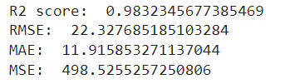
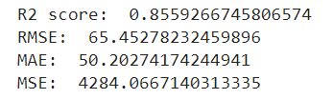
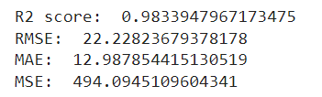
Results: For New Delhi
Using Random Forest
B) Support Vector Regressor
C) CatBoost Regressor

Slide 20

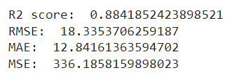
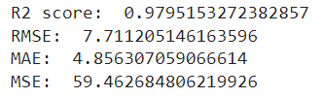
Results: For Bengaluru
Using Random Forest
B) SVR
C) CatBoost

Slide 21
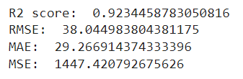
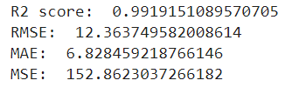
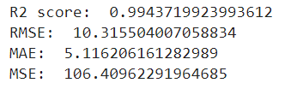
Results: For Kolkata
Using Random Forest
B) SVR
C) CatBoost

Slide 22
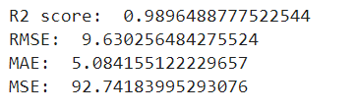
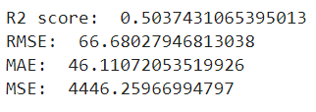
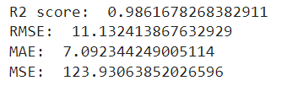
Results: For Hyderabad
Using Random Forest
B) SVR
B) CatBoost

Slide 23
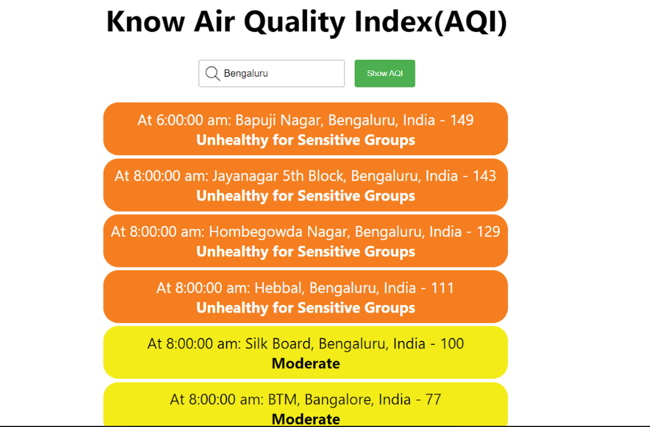
Results: Real Time AQI

Slide 24
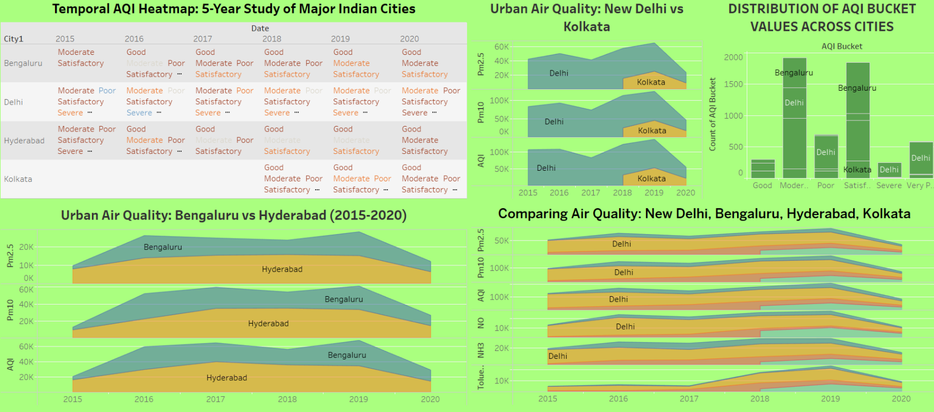
AQI Dashboard

Slide 25
Limitation
Relies on accurate and sufficient air quality data, which may be limited in some regions.
Forecasting models may not perfectly predict complex air quality dynamics.
The system can't directly control pollution sources, relying on external actions for mitigation.

Slide 26
Conclusion
Air quality in urban areas is a critical public health and environmental concern due to factors like industrial activities and vehicular emissions.
Advanced technologies, including machine learning, can revolutionize air quality monitoring and management in urban environments.
This project focuses on a real-time air quality monitoring system for cities, utilizing data from sources such as Kaggle or API
The goal is to provide instant updates on air quality to empower residents and authorities for informed decision-making.
Existing systems often calculate the daily Air Quality Index (AQI), but this project aims to predict hourly AQI to account for changing weather conditions.
Data used for prediction may contain outliers or anomalies, which can adversely affect the accuracy of the machine learning model.
Detecting and addressing outliers is a crucial aspect that needs attention to improve the model's performance.

Slide 27
Future Scope
Improved Data Integration: Integrating air quality data with other environmental datasets (e.g., weather, traffic) will lead to a more comprehensive understanding of pollution dynamics.
Machine Learning Applications: Machine learning can further enhance air quality forecasting, allowing for more accurate predictions and earlier warnings.
Real-time Decision Support Systems: Combining air quality data with real-time traffic management, energy production, and industrial emission control systems could lead to dynamic pollution mitigation strategies.

Slide 28
References
[1] Analyzed Research Papers:-
https://docs.google.com/document/d/1egy-c7UJd_XG-ZWv1WJ9uycaseoE6W2NtPNbWoNb9p0/edit?usp=sharing
[2] Prediction of Air Quality Index Using Machine Learning Techniques: A Comparative AnalysisN. Srinivasa Gupta,1Yashvi Mohta,2Khyati Heda,2Raahil Armaan,2B. Valarmathi,2and G. Arulkumaran, Hindawi Journal of Environmental and Public Health, Volume 2023, Article ID 4916267
[3] Urban Air Quality Prediction Using Regression Analysis, Soubhik Mahanta; T. Ramakrishnudu; Rajat Raj Jha; Niraj Tailor, TENCON 2019 - 2019 IEEE Region 10 Conference (TENCON)
[4] M. Bansal, “Air quality index prediction of Delhi using LSTM,” Int. J. Emerg. Trends Technol. Comput. Sci, vol. 8, pp. 59–68, 2019.
[5] N. Srinivasa Gupta , Yashvi Mohta, Khyati Heda, Raahil Armaan, Valarmathi and G. Arulkumaran, “Prediction of Air Quality Index Using Machine Learning Techniques: A Comparative Analysis” Journal of Environmental and Public Health

